Slide 1
Vx SBP Daily Monitoring

Slide 2

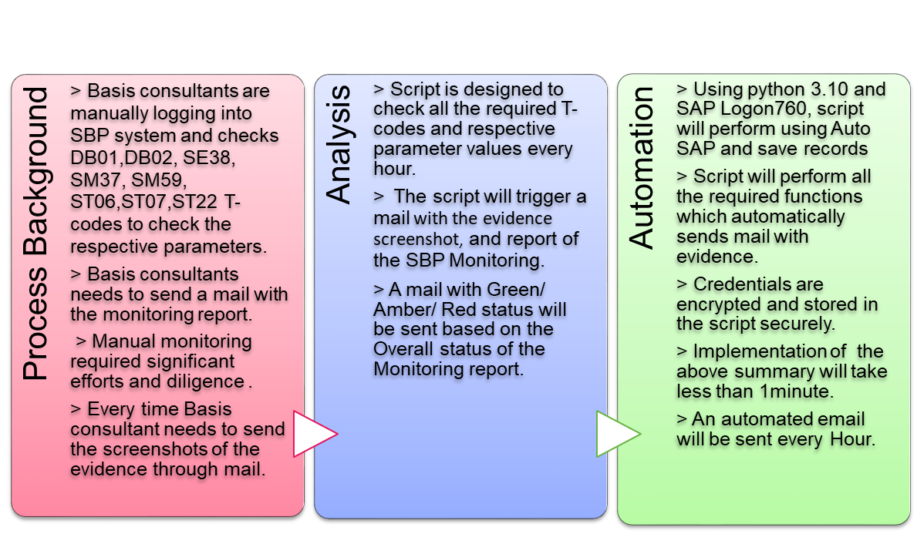
Vx Daily Monitoring
Business Value
90%
  Reduction in execution time
100%
  Data Accuracy
Zero
  Manual intervention
Evidence
  Better Documentation
240 Hours
  Efforts saved per month-If Monitored Hourly

Slide 3

Automation Flow Chart:
Login to SAP (SBP system)
Enter T-Code
Extract the Data and Store the Evidence
Generate the Report with respective Values and Status
Send Alert Mail with the Report and Overall Status by Attaching all the Evidence
Logout from SAP

Slide 4
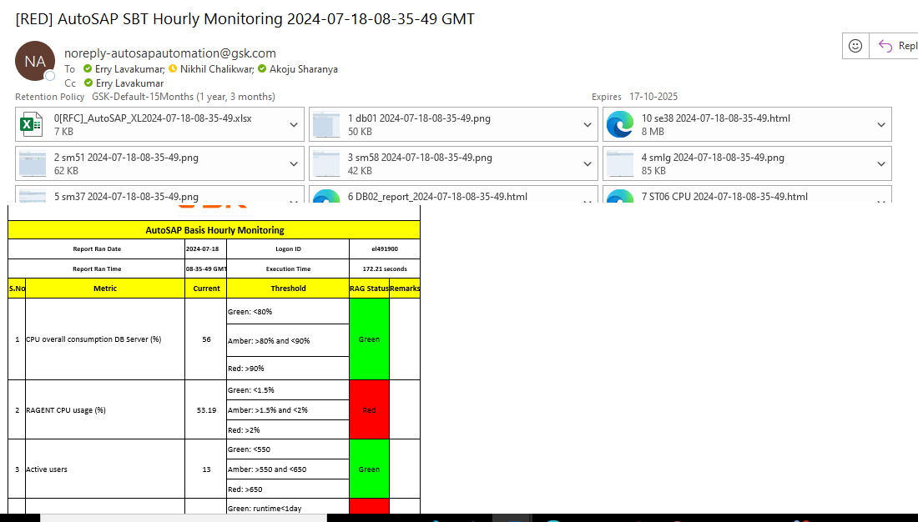
Mail Output:

Slide 5
Thank You

